Slide 1
Parallel Computing
杨广文
Institute of HPC
高性能计算所

Slide 2
杨广文
FIT3-112,010-62798985(O)
13911603112
ygw@tsinghua.edu.cn
张武生
FIT3-103, 010-62798982(O)
zws@tsinghua.edu.cn
甘霖
FIT3-113, 010-62797143(O)
lingan@tsinghua.edu.cn

Slide 3
Contents
Introduction to Parallel Computing
Parallel Programming Platforms
Principle of Parallel Algorithm Design
Basic Computation Operations
Analytical Modeling of Parallel Programs
Programming Using the Message-Passing Paradigm
Programming Shared Address Space Platforms
Dense Matrix Algorithms
Sorting Algorithms
Graph Algorithms
Search Algorithms for discrete Optimization Programming
Dynamic Programming
Fast Fourier Transform

Slide 4
CHAPTER 1
Introduction to Parallel Computing

Slide 5

1.1 Definition of Parallel Computing
Parallel computing is a form of computation in which many calculations are carried out simultaneously, operating on the principle that large problems can often be divided into smaller ones, which are then solved concurrently ("in parallel").

Slide 6
Compare to Other concepts
Parallel computing
Distributed Computing
High Performance Computing
High Productivity Computing
Pervisive Computing
Meta Computing
Grid Computing
Cloud Computing

Slide 7
Parallel Computer
A computer (a single machine) with multiple-(many) processors
  Multi-core
  Multi-processor
  Many-core
  Many-Processor
In generalized meaning (multiple computers )
  Cluster
  MPP
  Grid

Slide 8
Topologies of Parallel computers
Symmetric Multiprocessor
  Multiple processors in box with shared memory communication
  Current MultiCore chips like this
  Every processor runs copy of OS
Non-uniform shared-memory with separate I/O through host
  Multiple processors
    Each with local memory
    general scalable network
  Extremely light “OS” on node provides simple services
    Scheduling/synchronization
  Network-accessible host for I/O
Cluster
  Many independent machine connected with general network
  Communication through messages
P
P
P
P
Bus
Memory
P/M
P/M
P/M
P/M
P/M
P/M
P/M
P/M
Host
P/M
P/M
P/M
P/M
P/M
P/M
P/M
P/M
Network
Notes:
CS258 S99

Slide 9
Units of Measure in Parallel Computer
High Performance Computing (HPC) units are:
  Flop: floating point operation
  Flops: floating point operations per second
  Bytes: size of data (a double precision floating point number is 8)
Typical sizes are millions, billions, trillions…
  Mega Mflops = 10⁶ flops/sec Mbyte = 2²⁰ ~ 10⁶ bytes
  Giga Gflop/s = 10⁹ flops/sec Gbyte = 2³⁰ ~ 10⁹ bytes
  Tera Tflop/s = 10¹² flops/sec Tbyte = 2⁴⁰ ~ 10¹² bytes
  Peta Pflop/s = 10¹⁵ flops/sec Pbyte = 2⁵⁰ ~ 10¹⁵ bytes
  Exa Eflop/s = 10¹⁸ flops/sec Ebyte = 2⁶⁰ ~ 10¹⁸ bytes
  Zetta Zflop/s = 10²¹ flops/sec Zbyte = 2⁷⁰ ~ 10²¹ bytes
  Yotta Yflop/s = 10²⁴ flops/sec Ybyte = 2⁸⁰ ~ 10²⁴ bytes
Notes:
Add definition of flop, where are current machines (size speed)
Today (Jan 06): largest machine is IBM BlueGene/L with 131072 processors, 367 Gflops peak,
mem >= 25 Terabytes=190 MB/proc out of 256MB/proc = 33.5TB available
Sum of performance over top500 computers in the world: 2.3 petaflops

Slide 10
Architecture
Tightly coupled scalable message-passing platform
Inexpensive clusters of workstations
Clusters of multiprocessor workstations
Clusters of servers

Slide 11
Programming Model
A decade back
Custom APIs
Current
Standard API
  Massage Passing Libraries: PVM, MPI
  Thread Libraries: POSIX threads
  Directive Based Models: OpenMP
  GUDA，Athred（OpenMP，OpenCL，OpenACC）

Slide 12

Application
Computation-intensive Applications
  Fluid dynamics
  Structural mechanics
  Signal processing
Data-intensive applications
  Transaction processing
  Information retrieval
  Data mining and analysis
  Multimedia services
  Computational biology
  Nanotechnology
  Network-intensive applications

Slide 13
Parallel Algorithms
Design , Analysis, Implementations of Parallel Algorithms
Emphasis of design :
Mapping tasks to specific topologies
Programmability
Portability
Scalebility

Slide 14
Aspect of Parallel Computing
Problems
Parallel algorithms
Programming tools
Parallel Programming Enviroment
Operation System (Middleware)
Parallel Computer (Architecture)
Notes:
Ecosystem

Slide 15
1.2 Motivating Parallelism
Development of parallel is time and effort intensive
    inherent complexity of specifying
    coordinating concurrent tasks
    lack of portable algorithms, standardized environments, and software development toolkits
The brisk rate of development of microprocessors
Question: the need for devoting significant effort towards exploiting parallelism as a means of accelerating applications?

Slide 16
Tunnel Vision by Experts
“I think there is a world market for maybe five computers.”
    Thomas Watson, chairman of IBM, 1943.
“There is no reason for any individual to have a computer in their home”
    Ken Olson, president and founder of Digital Equipment Corporation, 1977.
“640K [of memory] ought to be enough for anybody.”
    Bill Gates, chairman of Microsoft,1981.

Slide 17
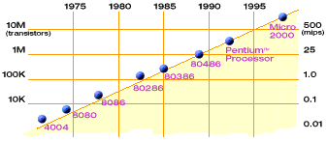
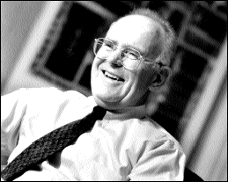
Moore’s Law
1.2.1The Computational Power
Moore’s Law
2X transistors/Chip Every 1.5 years
Called “Moore’s Law”
Gordon Moore (co-founder of Intel) predicted in 1965 that the transistor density of semiconductor chips would double roughly every 18 months.
Microprocessors have become smaller, denser, and more powerful.
Slide source: Jack Dongarra

Slide 18
More Limits: How fast can a serial computer be?
1 Tflop/s, 1 Tbyte sequential machine
r = 0.3 mm
Consider the 1 Tflop/s sequential machine:
  Data must travel some distance, r, to get from memory to CPU.
  To get 1 data element per cycle, this means 10¹² times per second at the speed of light, c = 3x10⁸ m/s. Thus r < c/10¹² = 0.3 mm.
Now put 1 Tbyte of storage in a 0.3 mm x 0.3 mm area:
  Each bit occupies about 1 square Angstrom, or the size of a small atom.
No choice but parallelism

Slide 19
1.2.2 The Memory/Disk speed
Clock rates of high-end processors have increased at roughly 40% per year
DRAM access times have only improved at the rate of roughly 10% per year
gap between processor speed and memory presents a tremendous performance bottleneck
processor speed and DRAM latency is typically bridged by caches

Slide 20
Parallel platforms typically yield better memory system performance
larger aggregate caches
higher aggregate bandwidth to the memory system
(both typically linear in the number of processors).
locality of data reference, also lend themselves to cache-friendly serial algorithms
parallel computing in data servers (database servers, web servers)
rely not so much on their high aggregate computation rates but rather on the ability to pump data out at a faster rate.

Slide 21
1.2.3 The Data Communication
using the Internet as one large heterogeneous parallel/distributed computing environment
  The SETI@home (Search for Extra Terrestrial Intelligence)
  factor extremely large integers and solve large discrete optimization problems.
infeasibility or undesirability of alternate (centralized) approaches
  there are constraints on the location of data and/or resources across the Internet

Slide 22

1.3 the important of Parallel computing

Slide 23
Simulation: The Third Pillar of Science
Traditional scientific and engineering paradigm:
  Do theory or paper design.
  Perform experiments or build system.
  Limitations:
    Too difficult -- build large wind tunnels.
    Too expensive -- build a throw-away passenger jet.
    Too slow -- wait for climate or galactic evolution.
    Too dangerous -- weapons, drug design, climate experimentation.
Computational science (Computational Engineering)
  Use high performance computer systems to simulate the phenomenon
    Base on known physical laws and efficient numerical methods.
    Across subject

Slide 24
Some definitions for computing
Computer Science
Computer engineering
Computational science
Computational Science and Engineering

Slide 25
Computer Science
Computer science(abbreviated CS ) is the scientific and practical approach to computation and its applications.

Slide 26
Theoretical computer science
    Theory of computation
    Information and coding theory
    Algorithms and data structures
    Programming language theory
    Formal methods
    Concurrent, parallel and distributed systems
    Databases and information retrieval

Slide 27
Applied computer science
    Artificial intelligence
    Computer architecture and engineering
    Computer graphics and visualization
    Computer security and cryptography
    Computational science
    Health Informatics
    Information science
    Software engineering

Slide 28
Computer engineering
Computer engineering is a discipline that integrates several fields of electrical engineering and computer science required to develop computer hardware and software
  Computer Software Engineering
  Computer Hardware Engineering

Slide 29
Specialty Areas
  Coding, Cryptography, and Information Protection
  Communications and Wireless Networks
  Compilers and Operating Systems
  Computational Science and Engineering
  Computer Networks, Mobile Computing, and Distributed Systems
  Computer Systems: Architecture, Parallel Processing, and Dependability
  Computer Vision and Robotics
  Embedded Systems
  Integrated Circuits, VLSI Design, Testing, and CAD
  Signal, Image, and Speech Processing

Slide 30
Computational science
Computational science (also scientific computing or scientific computation) is concerned with constructing mathematical models and quantitative analysis techniques and using computers to analyze and solve scientific problems
Applications of computational science
  Numerical simulations
  Model fitting and data analysis
  Computational optimization
Methods and algorithms

Slide 31
Computational science and Engineering
Computational science and engineering (CSE) is a relatively new discipline that deals with the development and application of computational models and simulations, often coupled with high-performance computing, to solve complex physical problems arising in engineering analysis and design (computational engineering) as well as natural phenomena (computational science).
CSE has been described as the "third mode of discovery" (next to theory and experimentation).In many fields, computer simulation is integral and therefore essential to business and research.

Slide 32
diverse applications of CSE
Aerospace Engineering and Mechanical Engineering
Biology
Chemistry
Civil Engineering
Computer Engineering and Electrical Engineering
Industrial Engineering
Material Science
Nuclear Engineering
Petroleum engineering
Physics
Numerical weather prediction and Computational geophysics
Battlefield simulations and military gaming
Astrophysical systems
Telecommunications
Transportation

Slide 33
The methods and frameworks of CSE
High performance computing and techniques to gain efficiency
Modeling and simulation
Algorithms for solving discrete and continuous problems
Analysis and visualization of data
Mathematical foundations: Numerical and applied linear algebra, initial & boundary value problems, Fourier analysis, optimization

Slide 34
Computing of CSE
With regard to computing, computer programming, algorithms, and parallel computing play a major role in CSE.

Slide 35
Why Parallelism
All major processor vendors are producing multicore chips
  Every machine is a parallel machine
  All programmers are parallel programmers
New software model
  Want a new feature? Hide the “cost” by speeding up the code first
  All programmers will be performance programmers
Some may eventually be hidden in libraries, compilers, and high level languages
  But a lot of work is needed to get there
Big open questions:
  What will be the killer apps for multicore machines
  How should the chips be designed, and how will they be programmed?
  What is the architecture of the Parallel Computer

Slide 36
Some Particularly Challenging Computations
Science
  Global climate modeling
  Biology: genomics; protein folding; drug design
  Astrophysical modeling
  Computational Chemistry
  Computational Material Sciences and Nanosciences
Engineering
  Semiconductor design
  Earthquake and structural modeling
  Computation fluid dynamics (airplane design)
  Combustion (engine design)
  Crash simulation
Business
  Financial and economic modeling
  Transaction processing, web services and search engines
Defense
  Nuclear weapons -- test by simulations
  Cryptography

Slide 37
Economic Impact of HPC
Airlines:
  System-wide logistics optimization systems on parallel systems.
  Savings: approx. $100 million per airline per year.
Automotive design:
  Major automotive companies use large systems (500+ CPUs) for:
    CAD-CAM, crash testing, structural integrity and aerodynamics.
    One company has 500+ CPU parallel system.
  Savings: approx. $1 billion per company per year.
Semiconductor industry:
  Semiconductor firms use large systems (500+ CPUs) for
    device electronics simulation and logic validation
  Savings: approx. $1 billion per company per year.
Securities industry

Slide 38
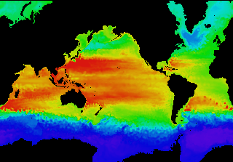
Global Climate Modeling Problem
Problem is to compute:
  f(latitude, longitude, elevation, time) →
  temperature, pressure, humidity, wind velocity
Approach:
  Discretize the domain, e.g., a measurement point every 10 km
  Devise an algorithm to predict weather at time t+δt given t
Uses:
  Predict major events, e.g., El Nino
  Use in setting air emissions standards
Source: http://www.epm.ornl.gov/chammp/chammp.html

Slide 39
Global Climate Modeling Computation
One piece is modeling the fluid flow in the atmosphere
  Solve Navier-Stokes equations
    Roughly 100 Flops per grid point with 1 minute timestep
Computational requirements:
  To match real-time, need 5 x 10¹¹ flops in 60 seconds = 8 Gflop/s
  Weather prediction (7 days in 24 hours) → 56 Gflop/s
  Climate prediction (50 years in 30 days) → 4.8 Tflop/s
  To use in policy negotiations (50 years in 12 hours) → 288 Tflop/s
To double the grid resolution, computation is 8x to 16x
State of the art models require integration of atmosphere, ocean, sea-ice, land models, plus possibly carbon cycle, geochemistry and more
Current models are coarser than this
Notes:
5e11 = [ 4*pi*(4000*1.6)^2 / 100 ] * 1000 vertical levels * 100 flops/cell

Slide 40
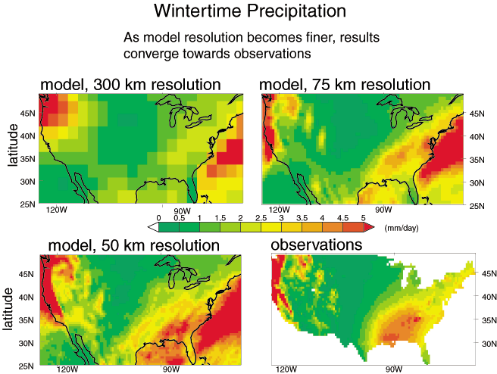
High Resolution Climate Modeling on NERSC-3 – P. Duffy, et al., LLNL

Slide 41
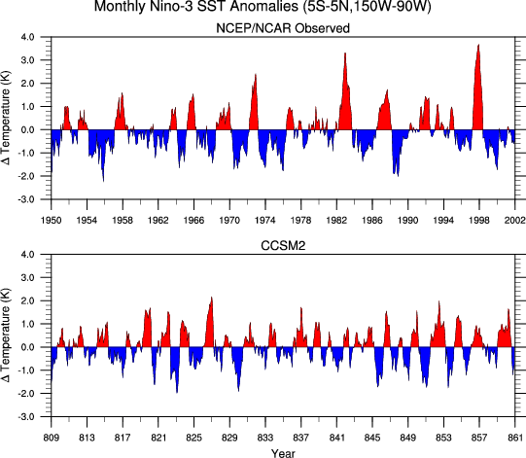
A 1000 Year Climate Simulation
Demonstration of the Community Climate Model (CCSM2)
A 1000-year simulation shows long-term, stable representation of the earth’s climate.
760,000 processor hours used
Temperature change shown
Warren Washington and Jerry Meehl, National Center for Atmospheric Research; Bert Semtner, Naval Postgraduate School; John Weatherly, U.S. Army Cold Regions Research and Engineering Lab Laboratory et al.
http://www.nersc.gov/news/science/bigsplash2002.pdf

Slide 42
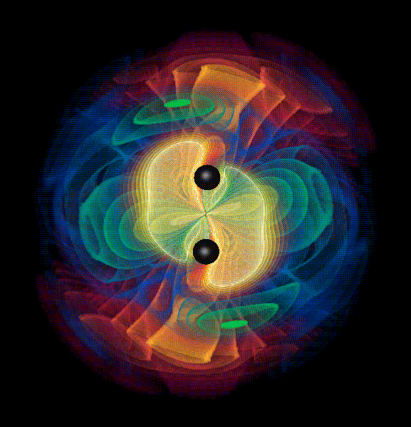
Astrophysics: Binary Black Hole Dynamics
Massive supernova cores collapse to black holes.
At black hole center spacetime breaks down.
Critical test of theories of gravity –
General Relativity to Quantum Gravity.
Indirect observation – most galaxies
have a black hole at their center.
Gravity waves show black hole directly
including detailed parameters.
Binary black holes most powerful
sources of gravity waves.
Simulation extraordinarily complex –
evolution disrupts the spacetime !
01/17/2007
CS267-Lecture 1

Slide 43
Heart Simulation
Problem is to compute blood flow in the heart
Approach:
  Modeled as an elastic structure in an incompressible fluid.
    The “immersed boundary method” due to Peskin and McQueen.
    20 years of development in model
    Many applications other than the heart: blood clotting, inner ear, paper making, embryo growth, and others
  Use a regularly spaced mesh (set of points) for evaluating the fluid
Uses
  Current model can be used to design artificial heart valves
  Can help in understand effects of disease (leaky valves)
  Related projects look at the behavior of the heart during a heart attack
  Ultimately: real-time clinical work

Slide 44
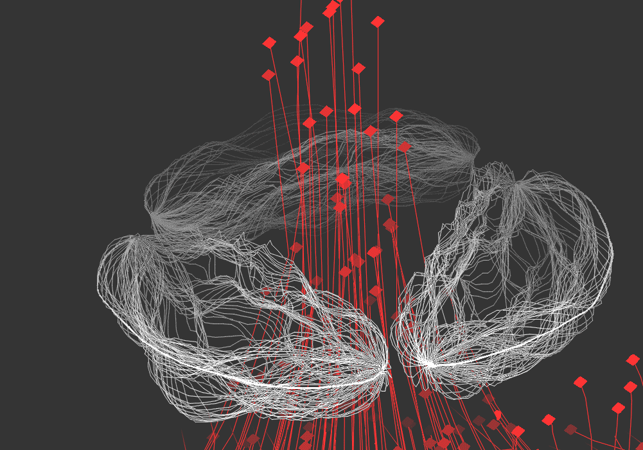
Heart Simulation Calculation
The involves solving Navier-Stokes equations
  64^3 was possible on Cray YMP, but 128^3 required for accurate model (would have taken 3 years).
  Done on a Cray C90 -- 100x faster and 100x more memory
  Until recently, limited to vector machines
Needs more features:
    Electrical model of the heart, and details of muscles, E.g.,
      Chris Johnson
      Andrew McCulloch
    Lungs, circulatory systems

Slide 45
Parallel Computing in Data Analysis
Finding information amidst large quantities of data
General themes of sifting through large, unstructured data sets:
  Has there been an outbreak of some medical condition in a community?
  Which doctors are most likely involved in fraudulent charging to medicare?
  When should white socks go on sale?
  What advertisements should be sent to you?
Data collected and stored at enormous speeds (Gbyte/hour)
  remote sensor on a satellite
  telescope scanning the skies
  microarrays generating gene expression data
  scientific simulations generating terabytes of data
  analysis of telecommunications

Slide 46
Principles of Parallel Computing
Finding enough parallelism (Amdahl’s Law)
Granularity
Locality
Load balance
Coordination and synchronization
Performance modeling
All of these things makes parallel programming even harder than sequential programming.

Slide 47
Forms of parallel computing
Bit level parallelism
  within floating point operations, etc.
Instruction level parallelism (ILP)
  multiple instructions execute per clock cycle
Memory system parallelism
  overlap of memory operations with computation
OS parallelism
  multiple jobs run in parallel on commodity SMPs
Data-level parallelism
Task-level Parallelism

Slide 48
TOP10 November 2015
Rank | Site | System | Cores | Rmax (TFlop/s) | Rpeak (TFlop/s) | Power (kW)
1 | National Super Computer Center in GuangzhouChina | Tianhe-2 (MilkyWay-2) - TH-IVB-FEP Cluster, Intel Xeon E5-2692 12C 2.200GHz, TH Express-2, Intel Xeon Phi 31S1PNUDT | 3,120,000 | 33,862.7 | 54,902.4 | 17,808
2 | DOE/SC/Oak Ridge National LaboratoryUnited States | Titan - Cray XK7 , Opteron 6274 16C 2.200GHz, Cray Gemini interconnect, NVIDIA K20xCray Inc. | 560,640 | 17,590.0 | 27,112.5 | 8,209
3 | DOE/NNSA/LLNL United States | Sequoia - BlueGene/Q, Power BQC 16C 1.60 GHz, Custom IBM | 1,572,864 | 17,173.2 | 20,132.7 | 7,890
4 | RIKEN Advanced Institute for Computational Science (AICS)Japan | K computer, SPARC64 VIIIfx 2.0GHz, Tofu interconnect Fujitsu | 705,024 | 10,510.0 | 11,280.4 | 12,660
5 | DOE/SC/Argonne National LaboratoryUnited States | Mira - BlueGene/Q, Power BQC 16C 1.60GHz, CustomIBM | 786,432 | 8,586.6 | 10,066.3 | 3,945
6 | DOE/NNSA/LANL/SNL United States | Trinity - Cray XC40, Xeon E5-2698v3 16C 2.3GHz, Aries interconnect Cray Inc. | 301,056 | 8,100.9 | 11,078.9
7 | Swiss National Supercomputing Centre (CSCS)Switzerland | Piz Daint - Cray XC30, Xeon E5-2670 8C 2.600GHz, Aries interconnect , NVIDIA K20x Cray Inc. | 115,984 | 6,271.0 | 7,788.9 | 2,325
8 | HLRS - Höchstleistungsrechenzentrum Stuttgart Germany | Hazel Hen - Cray XC40, Xeon E5-2680v3 12C 2.5GHz, Aries interconnect Cray Inc. | 185,088 | 5,640.2 | 7,403.5
9 | King Abdullah University of Science and Technology Saudi Arabia | Shaheen II - Cray XC40, Xeon E5-2698v3 16C 2.3GHz, Aries interconnect Cray Inc. | 196,608 | 5,537.0 | 7,235.2 | 2,834
10 | Texas Advanced Computing Center/Univ. of Texas United States | Stampede - PowerEdge C8220, Xeon E5-2680 8C 2.700GHz, Infiniband FDR, Intel Xeon Phi SE10PDell | 462,462 | 5,168.1 | 8,520.1 | 4,510

Slide 49
TOP10 June 2016
Rank | System | Cores | Rmax (TFlop/s) | Rpeak (TFlop/s) | Power (kW)
1 | Sunway TaihuLight - Sunway MPP, Sunway SW26010 260C 1.45GHz, Sunway , NRCPC ，National Supercomputing Center in Wuxi，China | 10,649,600 | 93,014.6 | 125,435.9 | 15,371
2 | Tianhe-2 (MilkyWay-2) - TH-IVB-FEP Cluster, Intel Xeon E5-2692 12C 2.200GHz, TH Express-2, Intel Xeon Phi 31S1P , NUDT National Super Computer Center in Guangzhou，China | 3,120,000 | 33,862.7 | 54,902.4 | 17,808
3 | Titan - Cray XK7, Opteron 6274 16C 2.200GHz, Cray Gemini interconnect, NVIDIA K20x , Cray Inc. DOE/SC/Oak Ridge National Laboratory，United States | 560,640 | 17,590.0 | 27,112.5 | 8,209
4 | Sequoia - BlueGene/Q, Power BQC 16C 1.60 GHz, Custom , IBM DOE/NNSA/LLNL，United States | 1,572,864 | 17,173.2 | 20,132.7 | 7,890
5 | K computer, SPARC64 VIIIfx 2.0GHz, Tofu interconnect , Fujitsu RIKEN Advanced Institute for Computational Science (AICS)，Japan | 705,024 | 10,510.0 | 11,280.4 | 12,660
6 | Mira - BlueGene/Q, Power BQC 16C 1.60GHz, Custom , IBM DOE/SC/Argonne National Laboratory，United States | 786,432 | 8,586.6 | 10,066.3 | 3,945
7 | Trinity - Cray XC40, Xeon E5-2698v3 16C 2.3GHz, Aries interconnect , Cray Inc. DOE/NNSA/LANL/SNL，United States | 301,056 | 8,100.9 | 11,078.9 | 4,233
8 | Piz Daint - Cray XC30, Xeon E5-2670 8C 2.600GHz, Aries interconnect , NVIDIA K20x , Cray Inc. Swiss National Supercomputing Centre (CSCS)，Switzerland | 115,984 | 6,271.0 | 7,788.9 | 1,754
9 | Hazel Hen - Cray XC40, Xeon E5-2680v3 12C 2.5GHz, Aries interconnect , Cray Inc. HLRS - Höchstleistungsrechenzentrum Stuttgart，Germany | 185,088 | 5,640.2 | 7,403.5 | 3,615
10 | Shaheen II - Cray XC40, Xeon E5-2698v3 16C 2.3GHz, Aries interconnect , Cray Inc. King Abdullah University of Science and TechnologySaudi Arabia | 196,608 | 5,537.0 | 7,235.2 | 2,834

Slide 50
神威太湖之光与国际其他超算系统的比较
System | TaihuLight | Tianhe-2 | Titan | Sequoia | Cori
Peak Performance (PFlops) | 125.4 | 54.9 | 27.1 | 20.1 | 27.9
Total Memory (TB) | 1310 | 1024 | 710 | 1572 | 879
Linpack Performance (PFlops) | 93.0(74%) | 33.9(62%) | 17.6(65%) | 17.2(85.3) | 14.0(50%)
Rank of Top500 | 1 | 2 | 3 | 4 | 5
Performance/Power (Mflops/W) | 6051.3 | 1901.5 | 2142.8 | 2176.6 | 3266.8
Rank of Green500 | 4 | 135 | 100 | 90 | 26
GTEPS | 23755.7 | 2061.48 | ### | 23751 | ###
Rank of Graph500 | 2 | 8 | ### | 3 | ###
HPCG (Pflops) | 0.4808 | 0.5801 | 0.3223 | 0.3304 | 0.3554
Rank of HPCG | 3 | 2 | 7 | 6 | 5

Slide 51
TOP10 November 2017
Rank | System | Cores | Rmax (TFlop/s) | Rpeak (TFlop/s) | Power (kW)
1 | Sunway TaihuLight - Sunway MPP, Sunway SW26010 260C 1.45GHz, Sunway , NRCPC National Supercomputing Center in Wuxi，China | 10,649,600 | 93,014.6 | 125,435.9 | 15,371
2 | Tianhe-2 (MilkyWay-2) - TH-IVB-FEP Cluster, Intel Xeon E5-2692 12C 2.200GHz, TH Express-2, Intel Xeon Phi 31S1P , NUDT ，National Super Computer Center in Guangzhou | 3,120,000 | 33,862.7 | 54,902.4 | 17,808
3 | Piz Daint - Cray XC50, Xeon E5-2690v3 12C 2.6GHz, Aries interconnect , NVIDIA Tesla P100 , Cray Inc. Swiss National Supercomputing Centre (CSCS)，Switzerland | 361,760 | 19,590.0 | 25,326.3 | 2,272
4 | Gyoukou - ZettaScaler-2.2 HPC system, Xeon D-1571 16C 1.3GHz, Infiniband EDR, PEZY-SC2 700Mhz , ExaScaler ，Japan Agency for Marine-Earth Science and Technology，Japan | 19,860,000 | 19,135.8 | 28,192.0 | 1,350
5 | Titan - Cray XK7, Opteron 6274 16C 2.200GHz, Cray Gemini interconnect, NVIDIA K20x , Cray Inc. ，DOE/SC/Oak Ridge National Laboratory，United States | 560,640 | 17,590.0 | 27,112.5 | 8,209
6 | Sequoia - BlueGene/Q, Power BQC 16C 1.60 GHz, Custom , IBM ，DOE/NNSA/LLNL United States | 1,572,864 | 17,173.2 | 20,132.7 | 7,890
7 | Trinity - Cray XC40, Intel Xeon Phi 7250 68C 1.4GHz, Aries interconnect , Cray Inc. DOE/NNSA/LANL/SNL，United States | 979,968 | 14,137.3 | 43,902.6 | 3,844
8 | Cori - Cray XC40, Intel Xeon Phi 7250 68C 1.4GHz, Aries interconnect , Cray Inc. DOE/SC/LBNL/NERSC，United States | 622,336 | 14,014.7 | 27,880.7 | 3,939
9 | Oakforest-PACS - PRIMERGY CX1640 M1, Intel Xeon Phi 7250 68C 1.4GHz, Intel Omni-Path , Fujitsu ，Joint Center for Advanced High Performance Computing，Japan | 556,104 | 13,554.6 | 24,913.5 | 2,719
10 | K computer, SPARC64 VIIIfx 2.0GHz, Tofu interconnect , Fujitsu ，RIKEN Advanced Institute for Computational Science (AICS)，Japan | 705,024 | 10,510.0 | 11,280.4 | 12,660

Slide 52
TOP10 November 2018
Rank | System | Cores | Rmax (TFlop/s) | Rpeak (TFlop/s) | Power (kW)
1 | Summit - IBM Power System AC922, IBM POWER9 22C 3.07GHz, NVIDIA Volta GV100, Dual-rail Mellanox EDR Infiniband , IBM DOE/SC/Oak Ridge National Laboratory，United States | 2,397,824 | 143,500.0 | 200,794.9 | 9,783
2 | Sierra - IBM Power System S922LC, IBM POWER9 22C 3.1GHz, NVIDIA Volta GV100, Dual-rail Mellanox EDR Infiniband , IBM / NVIDIA / Mellanox DOE/NNSA/LLNL，United States | 1,572,480 | 94,640.0 | 125,712.0 | 7,438
3 | Sunway TaihuLight - Sunway MPP, Sunway SW26010 260C 1.45GHz, Sunway , NRCPC National Supercomputing Center in Wuxi，China | 10,649,600 | 93,014.6 | 125,435.9 | 15,371
4 | Tianhe-2A - TH-IVB-FEP Cluster, Intel Xeon E5-2692v2 12C 2.2GHz, TH Express-2, Matrix-2000 , NUDT National Super Computer Center in Guangzhou，China | 4,981,760 | 61,444.5 | 100,678.7 | 18,482
5 | Piz Daint - Cray XC50, Xeon E5-2690v3 12C 2.6GHz, Aries interconnect , NVIDIA Tesla P100 , Cray Inc. Swiss National Supercomputing Centre (CSCS)，Switzerland | 387,872 | 21,230.0 | 27,154.3 | 2,384
6 | Trinity - Cray XC40, Xeon E5-2698v3 16C 2.3GHz, Intel Xeon Phi 7250 68C 1.4GHz, Aries interconnect , Cray Inc. DOE/NNSA/LANL/SNL，United States | 979,072 | 20,158.7 | 41,461.2 | 7,578
7 | AI Bridging Cloud Infrastructure (ABCI) - PRIMERGY CX2570 M4, Xeon Gold 6148 20C 2.4GHz, NVIDIA Tesla V100 SXM2, Infiniband EDR , Fujitsu National Institute of Advanced Industrial Science and Technology (AIST)，Japan | 391,680 | 19,880.0 | 32,576.6 | 1,649
8 | SuperMUC-NG - ThinkSystem SD530, Xeon Platinum 8174 24C 3.1GHz, Intel Omni-Path , Lenovo ，Leibniz Rechenzentrum，Germany | 305,856 | 19,476.6 | 26,873.9
9 | Titan - Cray XK7, Opteron 6274 16C 2.200GHz, Cray Gemini interconnect, NVIDIA K20x , Cray Inc. ，DOE/SC/Oak Ridge National Laboratory，United States | 560,640 | 17,590.0 | 27,112.5 | 8,209
10 | Sequoia - BlueGene/Q, Power BQC 16C 1.60 GHz, Custom , IBM DOE/NNSA/LLNL，United States | 1,572,864 | 17,173.2 | 20,132.7 | 7,890

Slide 53
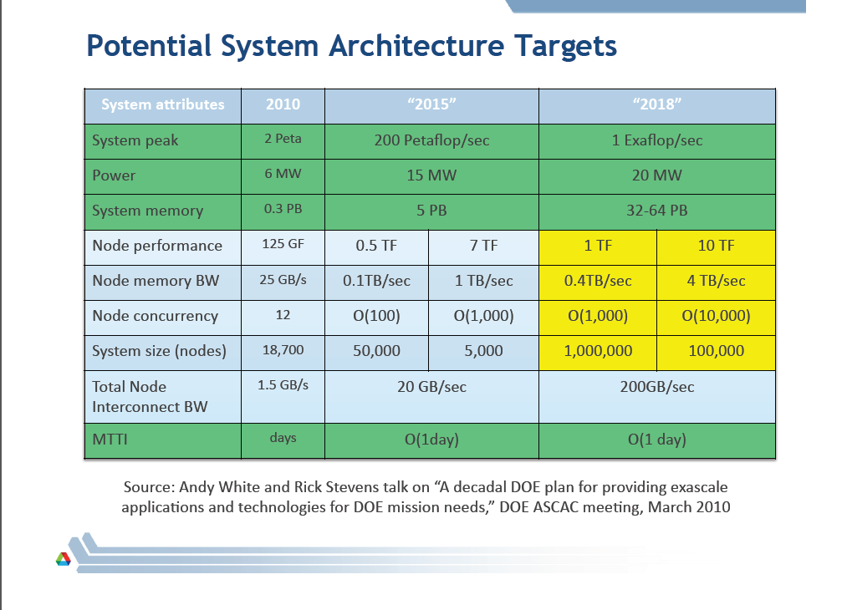

Slide 54
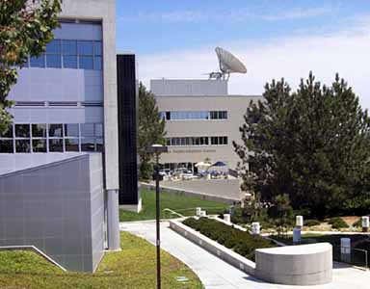
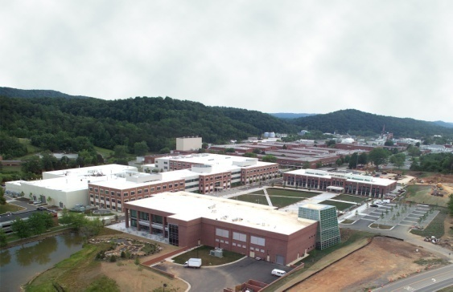

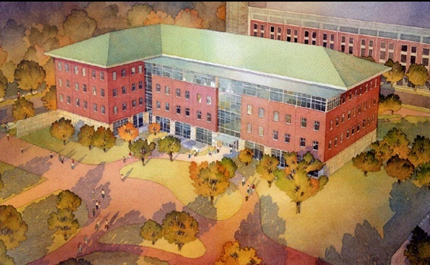
HPC Centers of USA
San Diego Supercomputer Center(NSF)
  San Diego, California（SCSD）
Oak Ridge National Laboratories(DOE)
  Oak Ridge, Tennessee（ORNL）
Pittsburgh Supercomputing Center(NSF)
  Pittsburgh, Pennsylvania（PSC）
National Center for Supercomputing
Applications(NSF)
  Urbana-Champaign, Illinois（NCSA）

Slide 55
中国高性能计算中心
广东超所中心 50P 2014，100P 2017
无锡超算中心 100P 2016
中科院网格中心 5T 100T（2008）
上海超算中心 10T 100T（2008）
其它研究机构及高校，总计算能力<500T
天津超算中心 1000T（2010.12）
深圳超算中心 1000T（2010.12）
山东超算中心 1000T（2010.12）
清华大学高性能计算中心 104TCPU+64TGPU

Slide 56

CACM, 2005.11 “Super Competition”

Slide 57

地球系统模式
基于地球系统中的动力、物理、化学和生物过程建立起来的数学物理模型，通过数值模拟来确定地球系统各子系统的性状，加深对全球变化机理的认识，并预测全球和区域气候与生态环境的变化
  主要再现气候变化事实、研究气候变化的机理、预估未来气候变化、为如何适应和减缓气候变化提供科学依据
复杂的多学科交叉研究
高性能数值模拟是唯一途径
海洋生物
海洋模式
海气交界面
大气模式
空间天气
冰水交界面
陆气交界面
耦合器
大气化学
动力冰雪
热力冰雪
陆面模式
陆面生物
雪地交界面
固体地球
水文过程

Slide 58
全球变化研究对高性能计算能力的需求
IPCC AR5 计算量巨大
    完成年代际预测的试验至少需运行2140模式年
    完成气候变化试验至少需运行5365模式年
    完成整个IPCC AR5所要求的评估试验，整个模式系统需积分7500个模式年以上
    提高分辨率对计算能力的一种形象说明
    “100公里”的全球模拟－－>十万亿次（10TFlops）
    “10公里”的全球模拟－－>万万亿次（10PFlops）
    “5公里”的全球模拟－－>十万万亿次（100PFlops）
    超级集合预报可利用任意大的计算能力

